Slide 1

Customer Churn
Presented By: Max Glasser, Tungalagtuya Naran, Francesca Palik & Joel Wiseman

Slide 2

What is Customer Churn?
Customer churn rate (CCR) is the essential metric for tracking how many customers are leaving your firm. It is always expressed as a percentage. It also always covers a specific period of time. For example, “a 10% customer churn rate for the last quarter”.
Another thing to bear in mind is that customer churn rate is the inverse of the customer retention rate. For example, if you have a churn rate of 10%, your retention rate is therefore 90%.
This matters because decision-makers looking at forecasting need to address customer churn to achieve their customer retention goals.

Slide 3
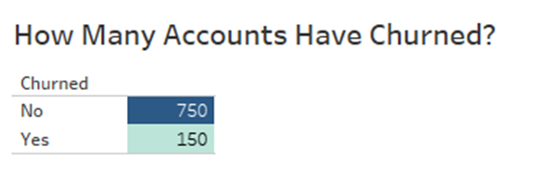
What about the Data Set?
A marketing agency has many customers who use their service to produce ads for customer websites. They've noticed that they have quite a bit of churn in clients. They randomly assign account managers but want to be more strategic by assigning their best account managers to the clients most at risk to churn. They have provided their historical client data, so that we can leverage to build a machine-learning model to quickly identify at-risk customers.
Key Data Points
Name: Name of the latest contact at Company
Age: Customer Age
Total Purchase: Total Ads Purchased
Account Manager: Binary 0=No manager, 1= Account manager assigned
Years: Total Years as a customer
Number of Websites Used: Number of websites that use the service.
Onboard Date: The date that the name of the latest contact was onboarded
Location: Client HQ Address
Company: Name of Client Company
Data Source: https://www.kaggle.com/datasets/hassanamin/customer-churn

Slide 4
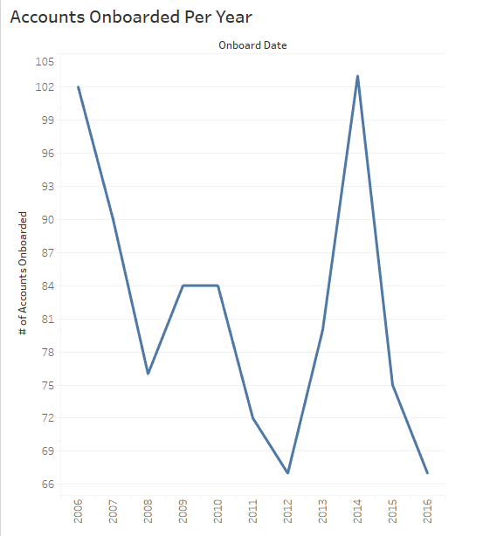
Data Overview

Slide 5
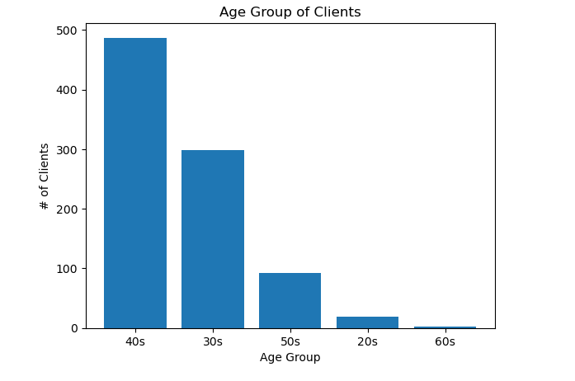
Data Overview

Slide 6
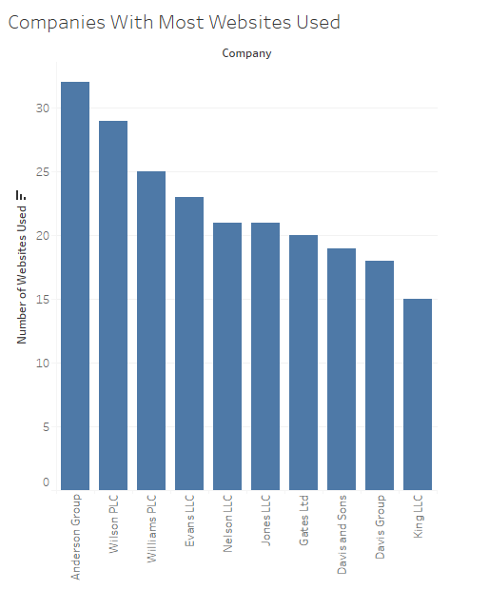
Data Overview

Slide 7
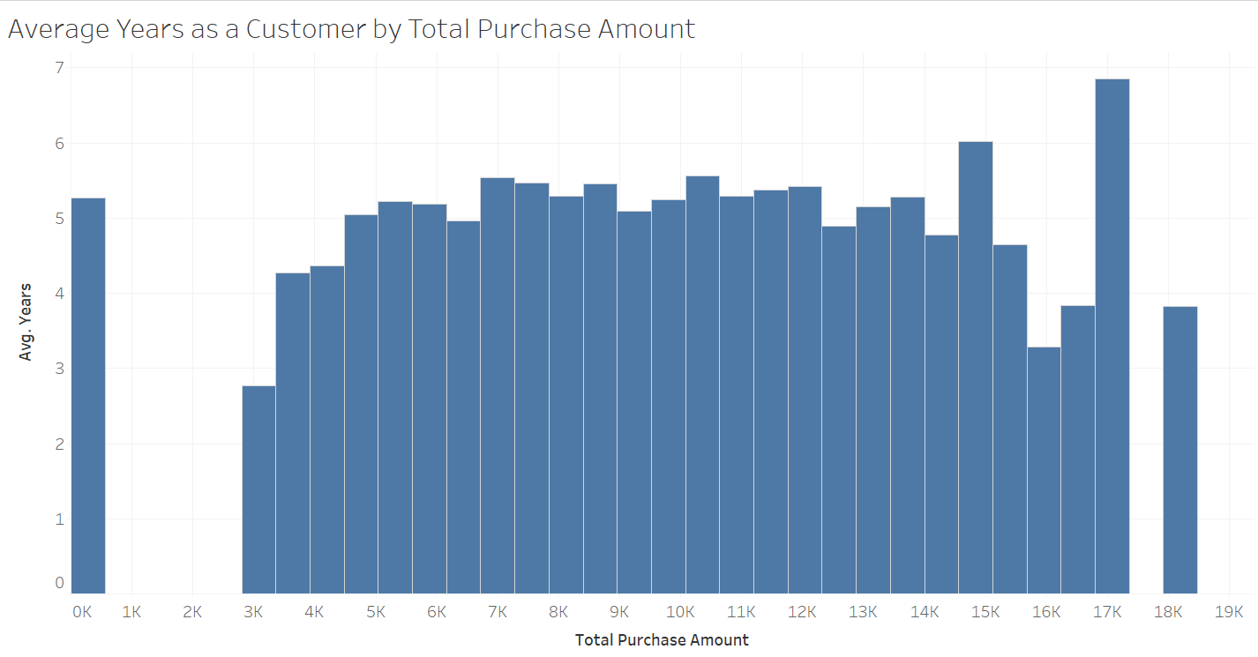
Data Overview

Slide 8
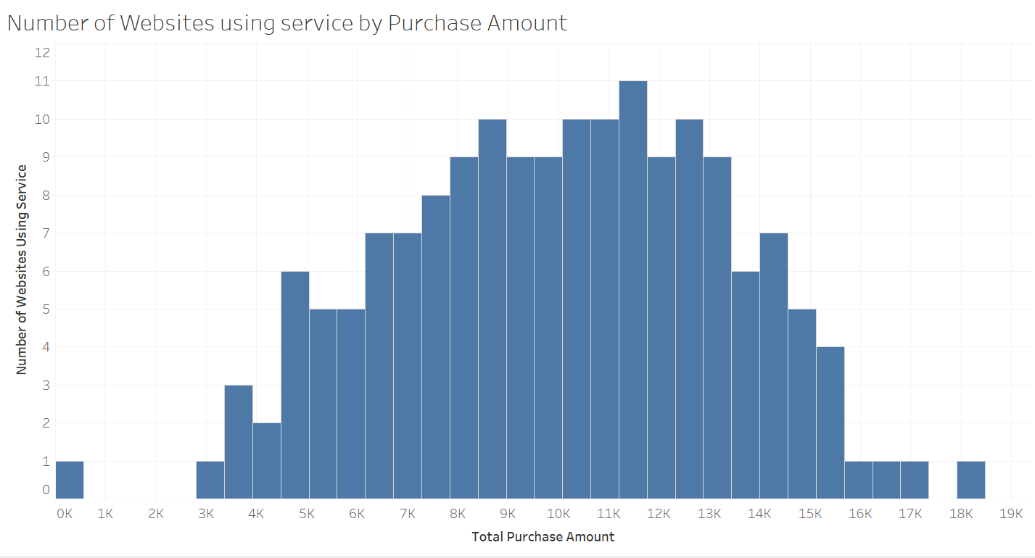
Data Overview

Slide 9
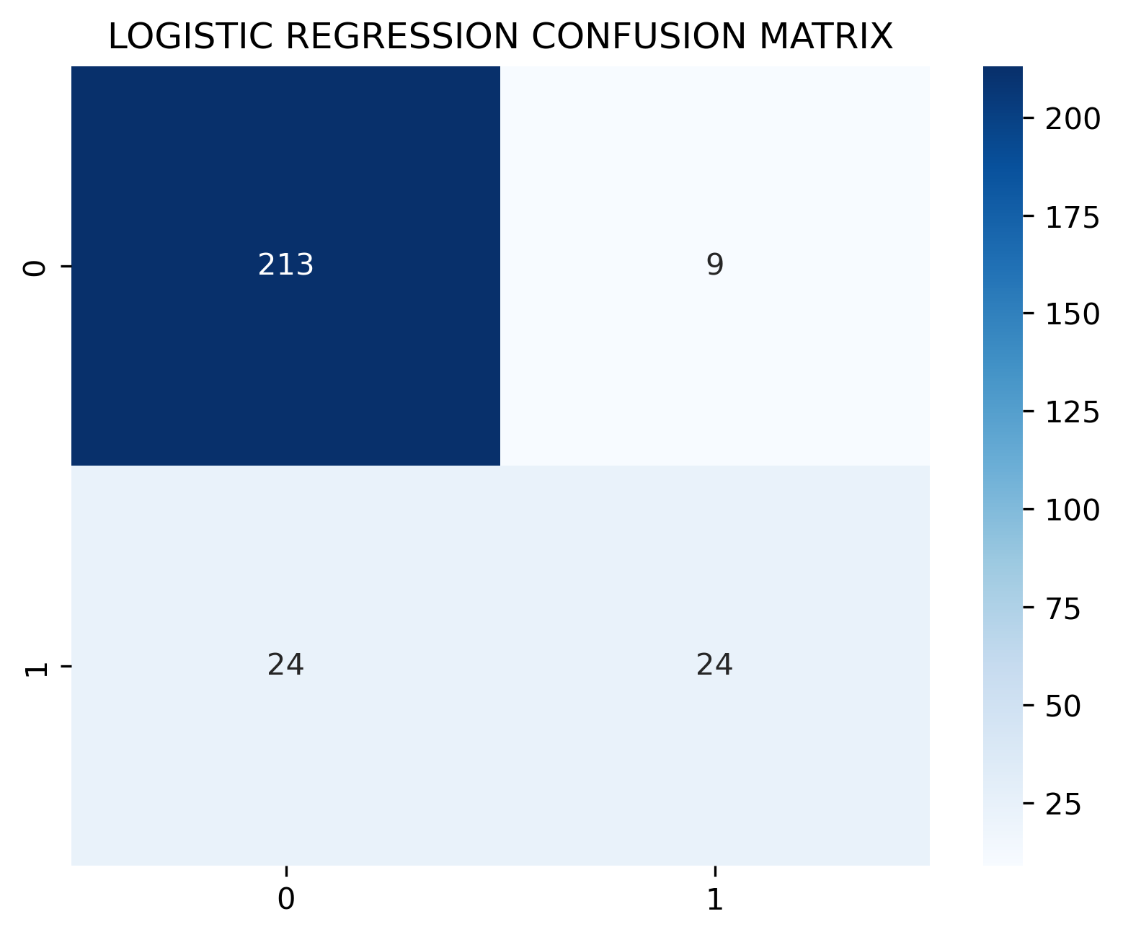
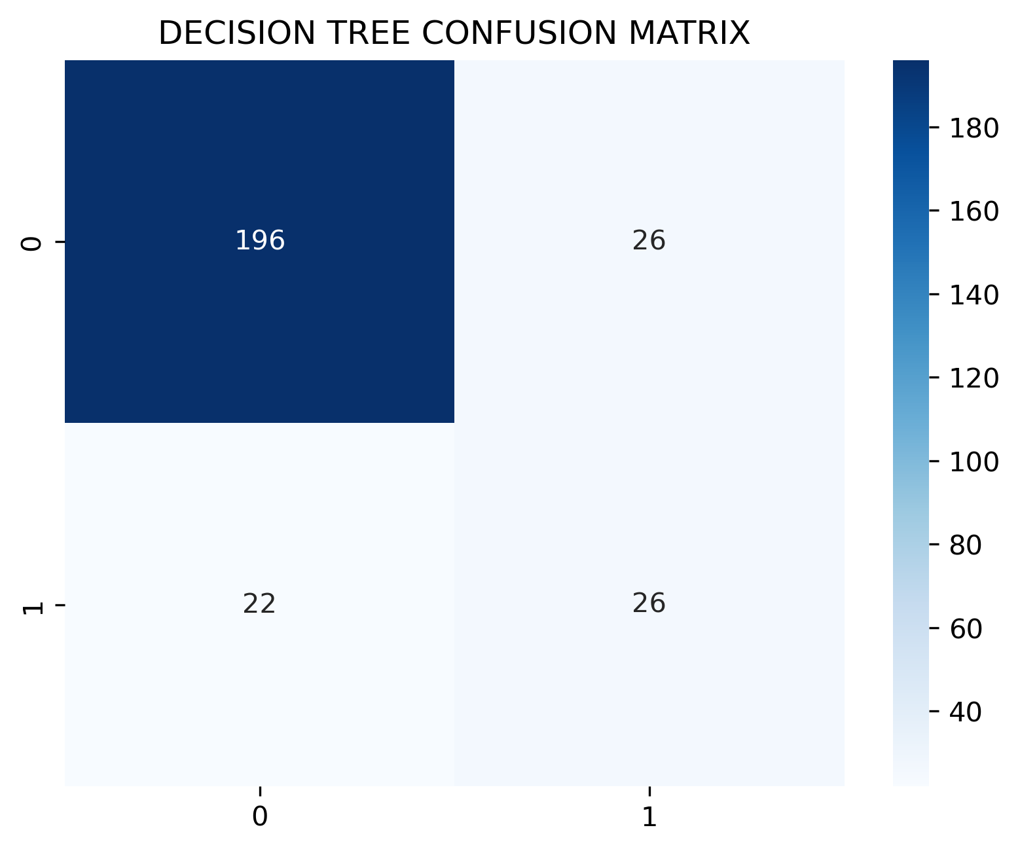
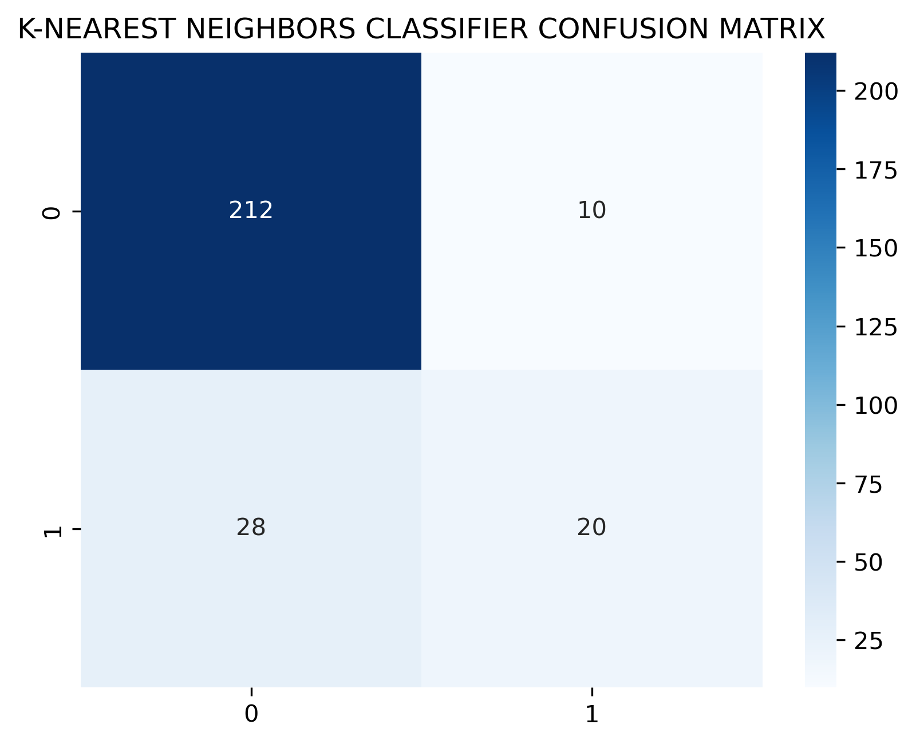
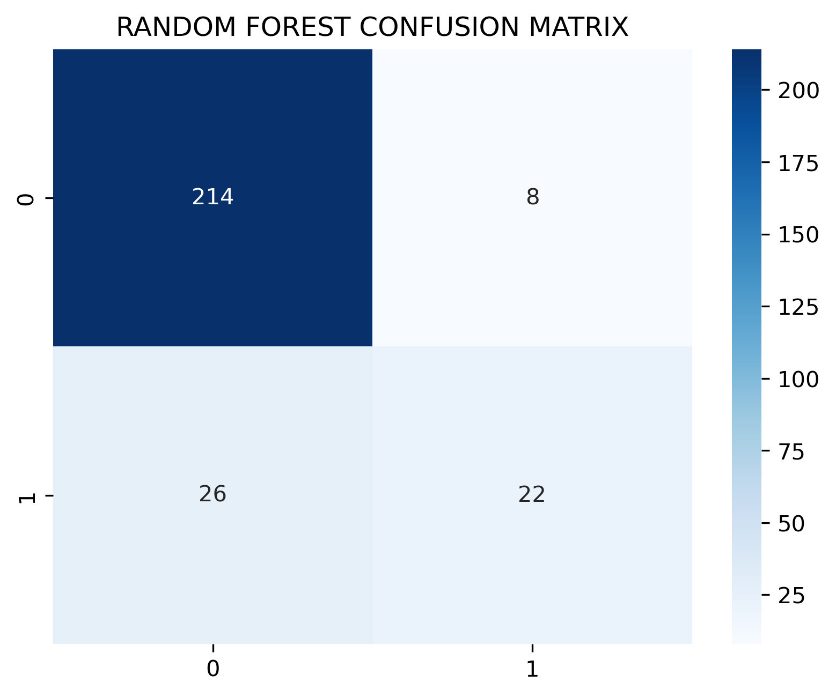
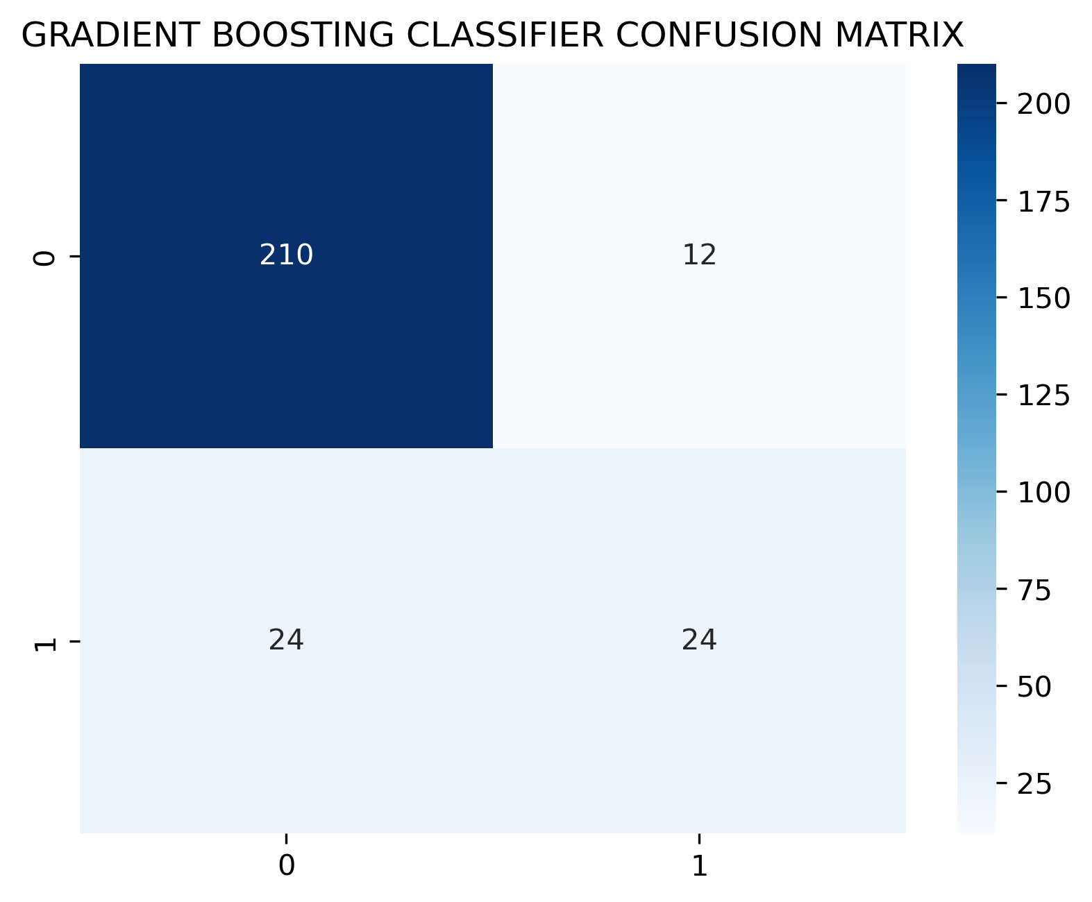
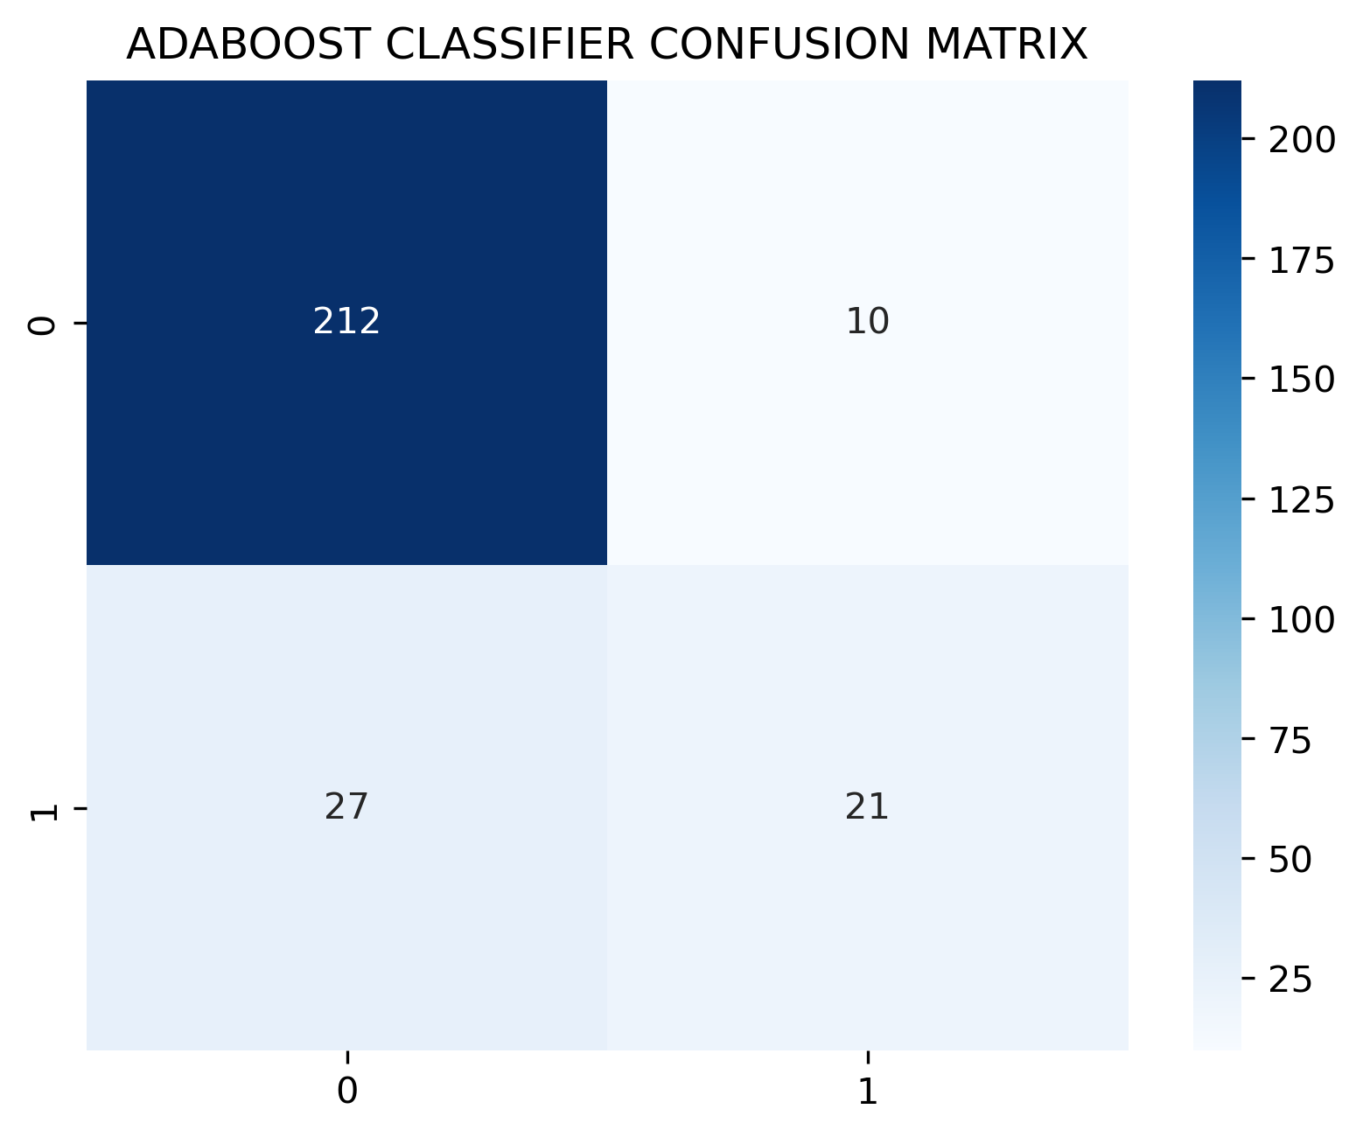
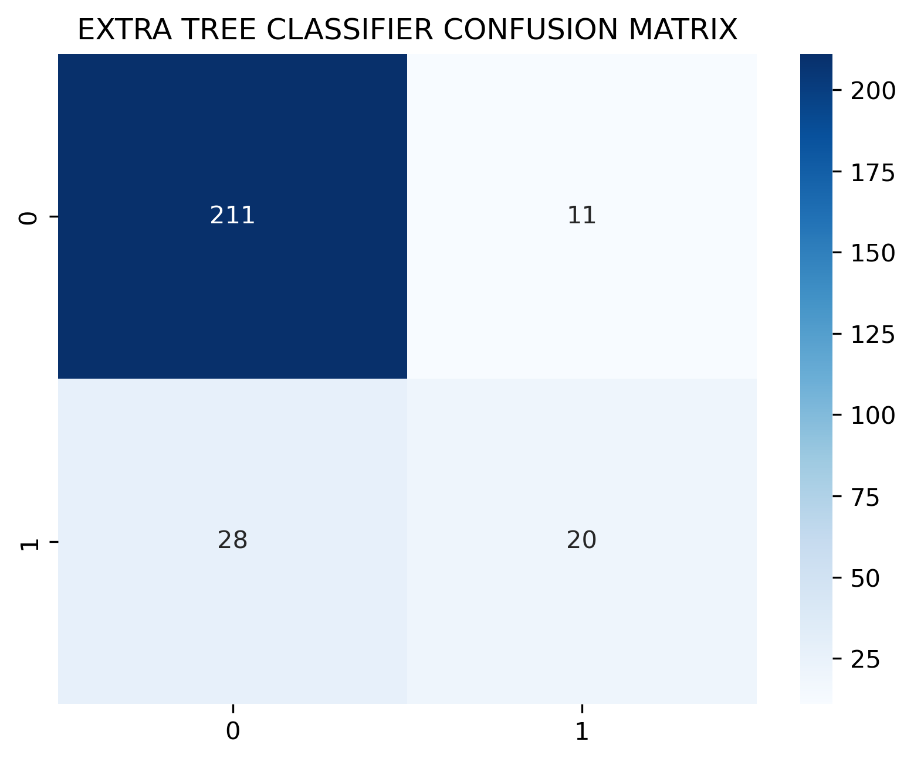
Data Exploration – Confusion Matrix
The Random Forest appears to have relatively better overall performance compared to the other algorithms.

Slide 10
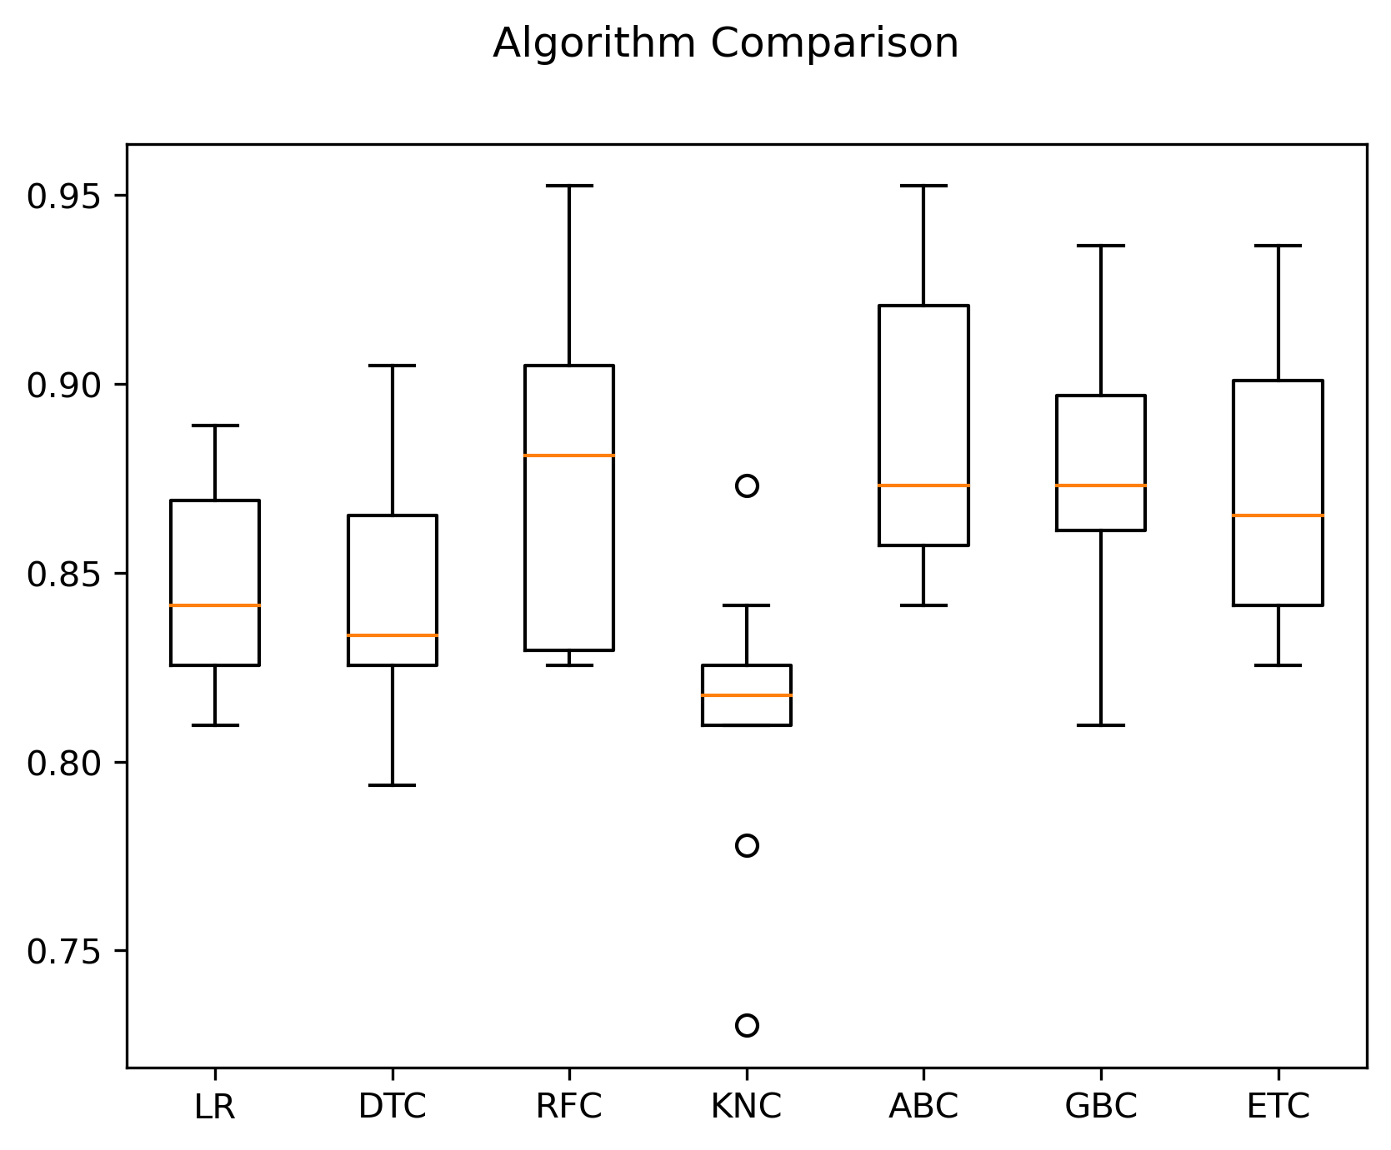
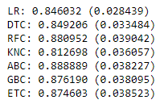
Data Exploration
Ada Boost Classifier is the best option for mean and standard deviation of the accuracy scores.

Slide 11
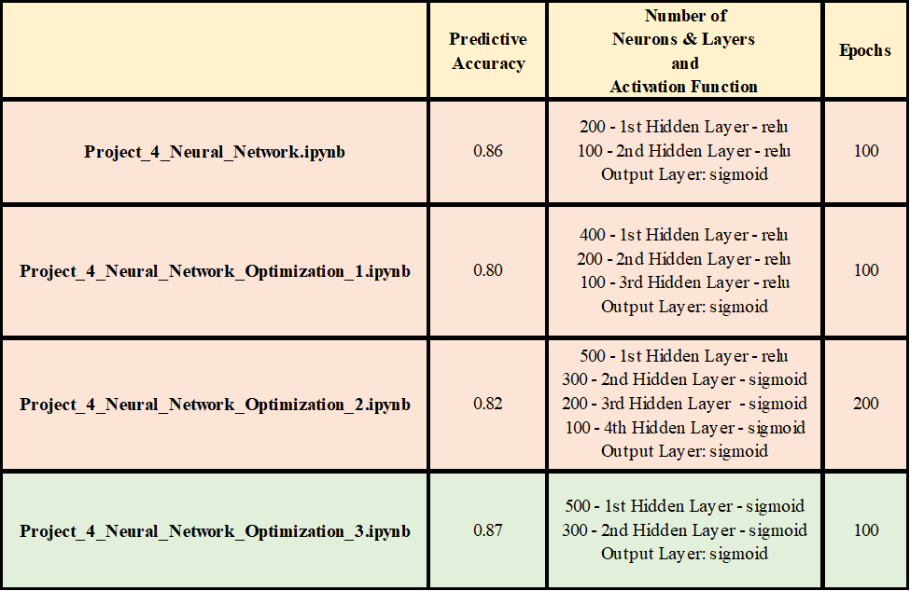
Neural Network

Slide 12
Challenges Faced
Neural Networks
Tableau Map

Slide 13
Conclusions
Add points from README

Slide 14


